Slide 1
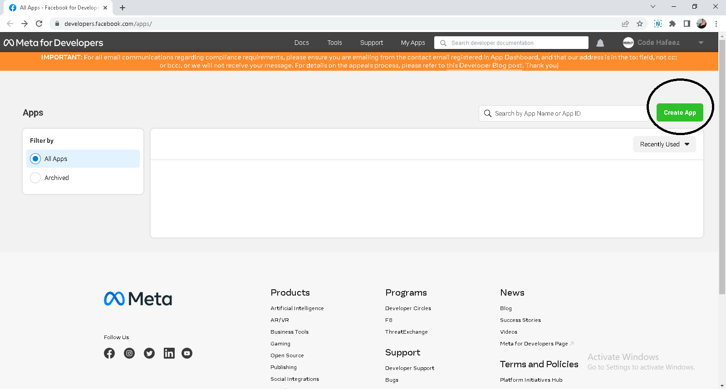
https://developers.facebook.com/

Slide 2
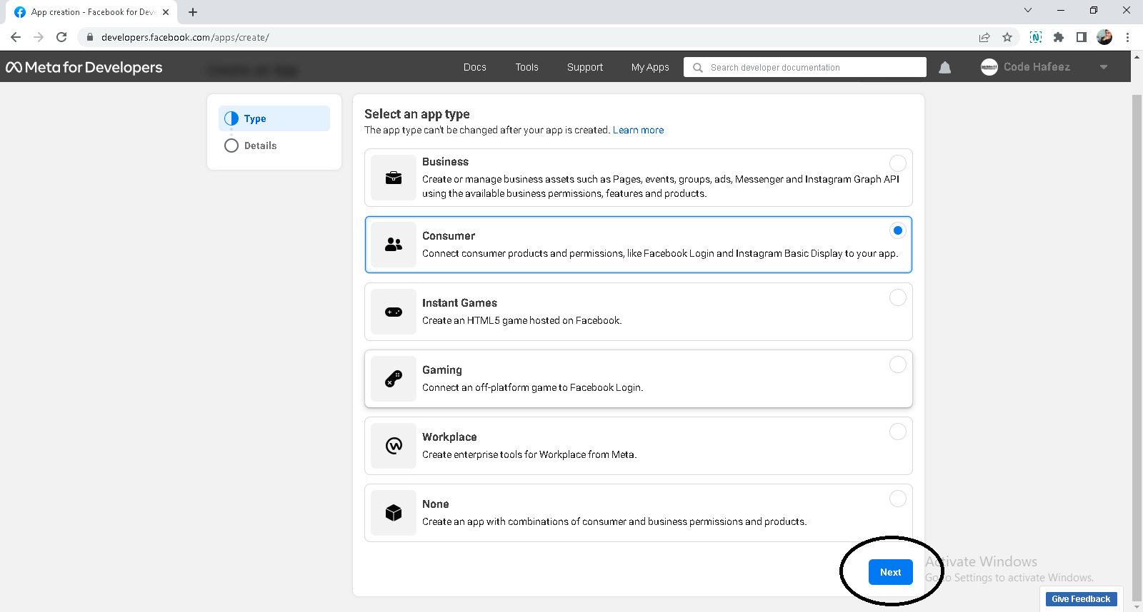

Slide 3
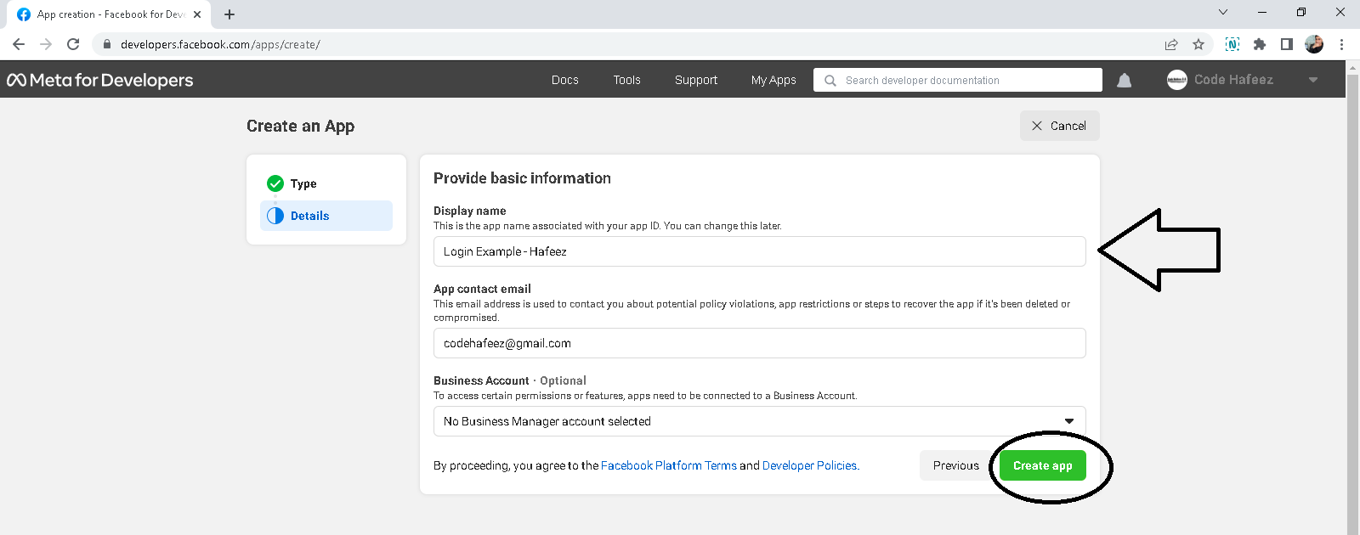

Slide 4
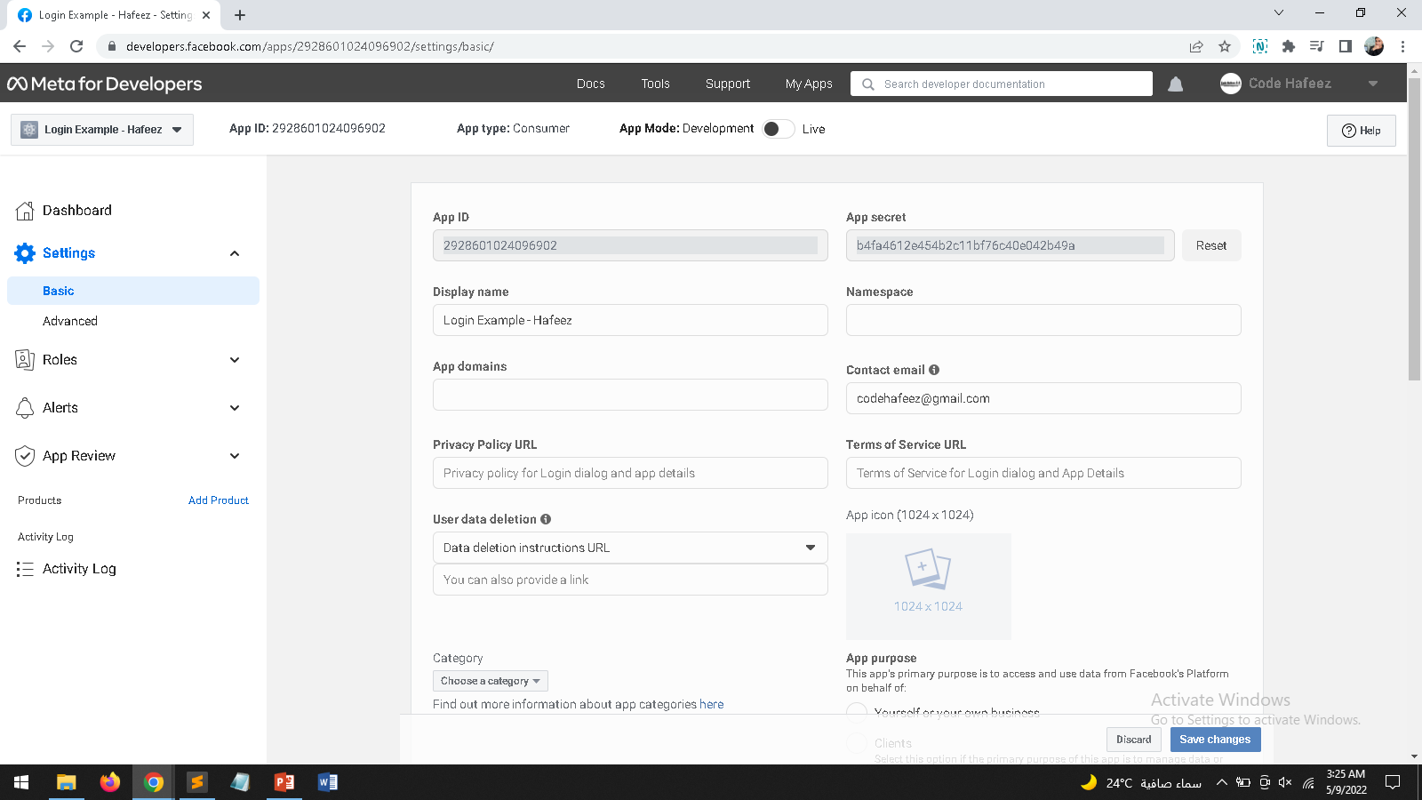

Slide 5
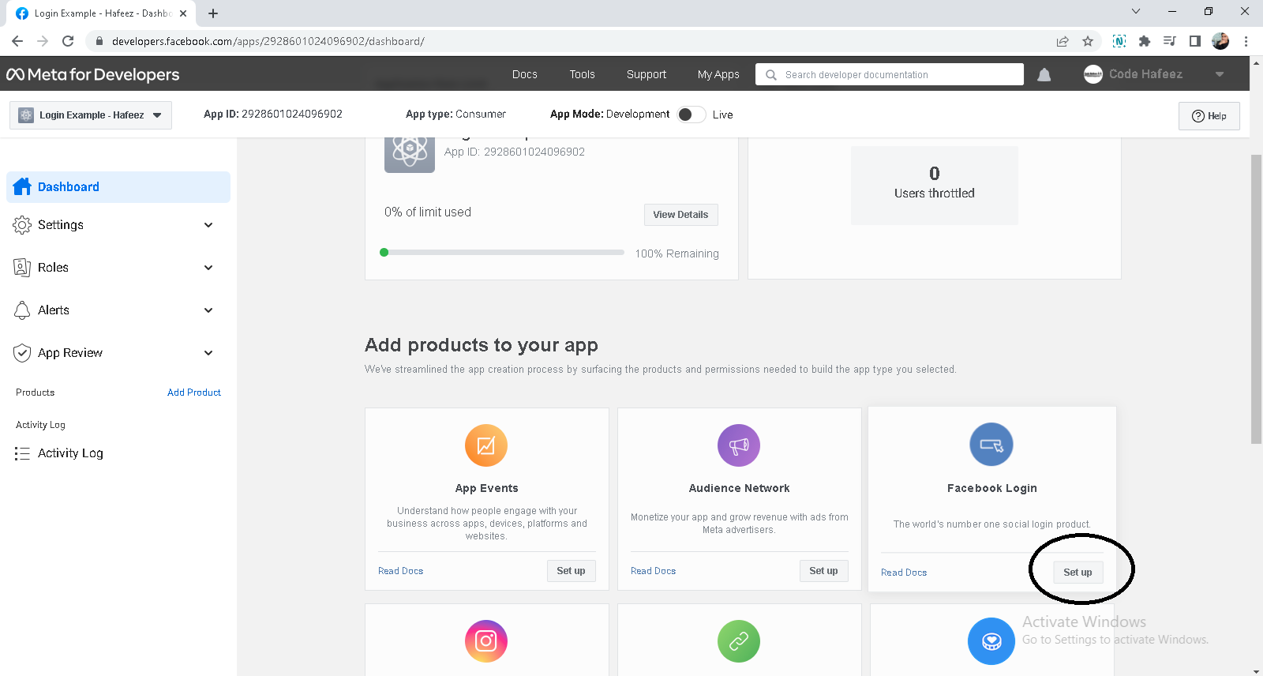

Slide 6
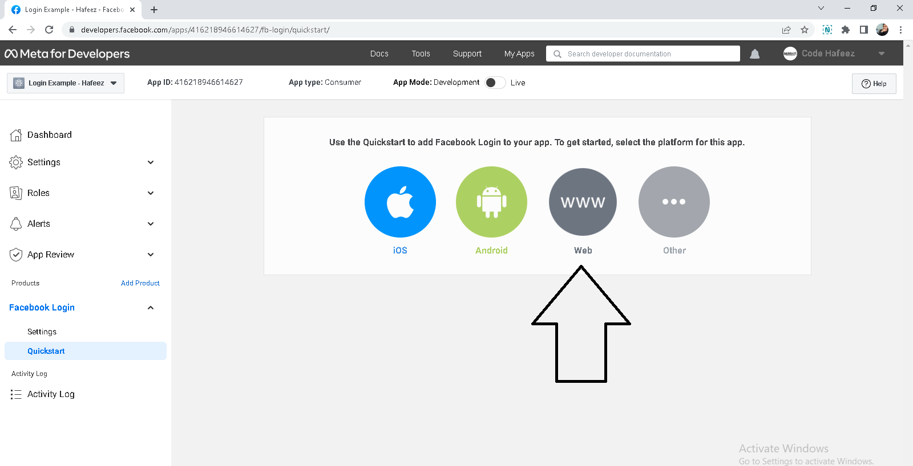

Slide 7
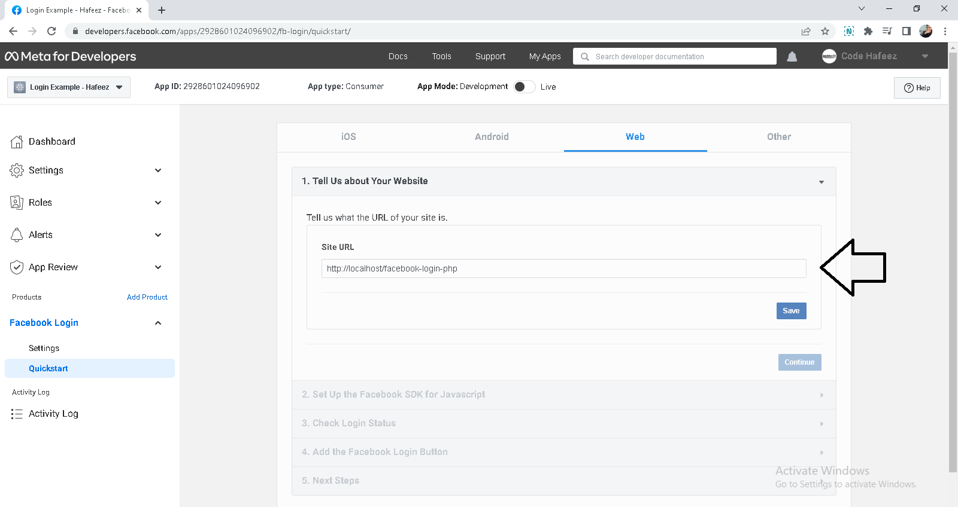

Slide 8
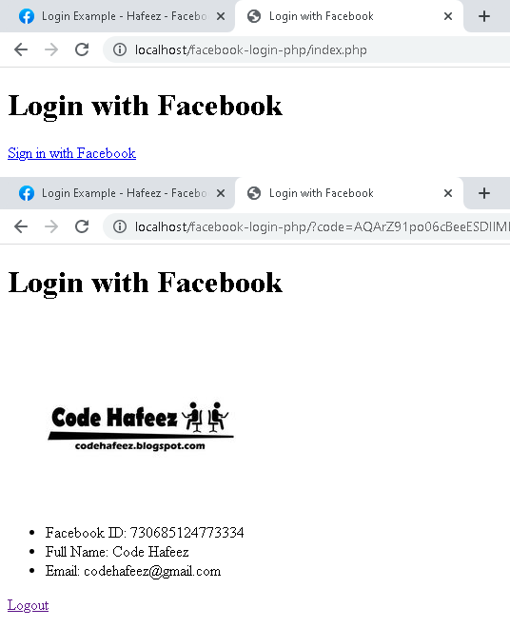
// index.php
<?php
require_once 'config.php';
if (isset($accessToken))
{
if (!isset($_SESSION['facebook_access_token']))
{
$_SESSION['facebook_access_token'] = (string) $accessToken;
$oAuth2Client = $fb->getOAuth2Client();
$longLivedAccessToken = $oAuth2Client->getLongLivedAccessToken($_SESSION['facebook_access_token']);
$_SESSION['facebook_access_token'] = (string) $longLivedAccessToken;
$fb->setDefaultAccessToken($_SESSION['facebook_access_token']);
}
else {
$fb->setDefaultAccessToken($_SESSION['facebook_access_token']);
}
try {
$fb_response = $fb->get('/me?fields=name,first_name,last_name,email');
$fb_response_picture = $fb->get('/me/picture?redirect=false&height=200');
$fb_user = $fb_response->getGraphUser();
$picture = $fb_response_picture->getGraphUser();
$_SESSION['fb_user_id'] = $fb_user->getProperty('id');
$_SESSION['fb_user_name'] = $fb_user->getProperty('name');
$_SESSION['fb_user_email'] = $fb_user->getProperty('email');
$_SESSION['fb_user_pic'] = $picture['url'];
} catch(Facebook\Exceptions\FacebookResponseException $e) {
echo 'Facebook API Error: ' . $e->getMessage();
session_destroy();
header("Location: ./");
exit;
} catch(Facebook\Exceptions\FacebookSDKException $e) {
echo 'Facebook SDK Error: ' . $e->getMessage();
exit;
}
}
?>
<!DOCTYPE html>
<html lang="en">
<head>
<title>Login with Facebook</title>
</head>
<body>
<h1>Login with Facebook</h1>
<?php if(isset($_SESSION['fb_user_id'])): ?>
<ul style="margin-top:30px">
<img src="<?php echo $_SESSION['fb_user_pic']; ?>">
<li>Facebook ID: <?php echo $_SESSION['fb_user_id']; ?></li>
<li>Full Name: <?php echo $_SESSION['fb_user_name']; ?></li>
<li>Email: <?php echo $_SESSION['fb_user_email']; ?></li>
</ul>
<a href="logout.php">Logout</a>
<?php else: ?>
<a href="<?= $fb_helper->getLoginUrl('http://localhost/facebook-login-php/')?>">Sign in with Facebook</a>
<?php endif ?>
</body>
</html>
// cinfig.php
<?php
// Include the autoloader provided in the SDK
require_once(__DIR__.'/Facebook/autoload.php');
define('APP_ID', '735375287844007');
define('APP_SECRET', 'cc9159ec7a339f3ca1d3e2c1d6558a61');
define('API_VERSION', 'v2.5');
if(!session_id()){
session_start();
}
// Call Facebook API
$fb = new Facebook\Facebook([
'app_id' => APP_ID,
'app_secret' => APP_SECRET,
'default_graph_version' => API_VERSION,
]);
$fb_helper = $fb->getRedirectLoginHelper();
try {
if(isset($_SESSION['facebook_access_token']))
{$accessToken = $_SESSION['facebook_access_token'];}
else
{$accessToken = $fb_helper->getAccessToken();}
} catch(FacebookResponseException $e) {
echo 'Facebook API Error: ' . $e->getMessage();
exit;
} catch(FacebookSDKException $e) {
echo 'Facebook SDK Error: ' . $e->getMessage();
exit;
}
?>
// logout.php
<?php
require_once 'config.php';
unset($_SESSION['facebook_access_token']);
unset($_SESSION['fb_user_id']);
unset($_SESSION['fb_user_name']);
unset($_SESSION['fb_user_email']);
unset($_SESSION['fb_user_pic']);
header("Location:index.php");
?>

